Slide 1

Chapter 12

Slide 2
Object-Oriented Design: Fundamentals
Chapter 12
Systems Analysis and Design in a Changing World 7th Ed
Satzinger, Jackson & Burd

Slide 3
Overview
This chapter and the next focus on designing software for the new system, at both the architectural and detailed level design
Design models are based on the requirements models learned in Chapters 3, 4, and 5
The steps of object-oriented design are explained
The main model discussed is the design class diagram
In this chapter, the CRC Cards technique is used to design the OO software
The chapter finishes with fundamental principles of good OO design

Slide 4
OO Design: Bridging from Analysis to Implementation
OO Design: Process by which a set of detailed OO design models are built to be used for coding
Strength of OO is requirements models from Chapters 3, 4, and 5 are extended to design models. No reinventing the wheel
Design models are created in parallel to actual coding/implementation with iterative SDLC
Agile approach says create models only if they are necessary. Simple detailed aspects don’t need a design model before coding

Slide 5
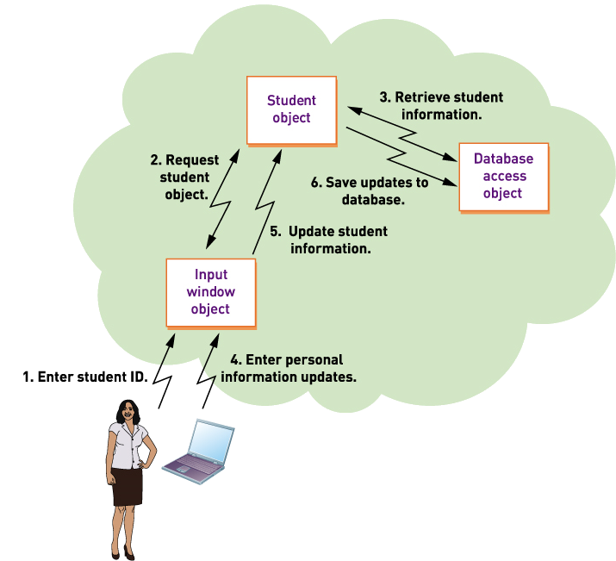
Object-Oriented Program Flow Three Layer Architecture

Slide 6
Object-Oriented Program Flow
Instantiation
Creation of an object in memory based on the template provided by the class
Method
The function executed within an object when invoked by a message request (method call)

Slide 7
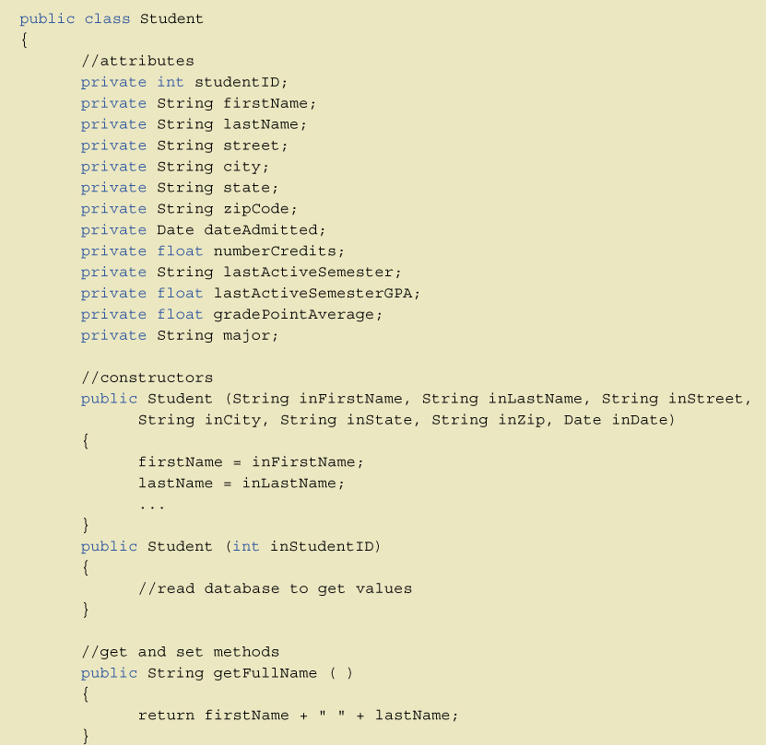
Sample Java with Methods

Slide 8
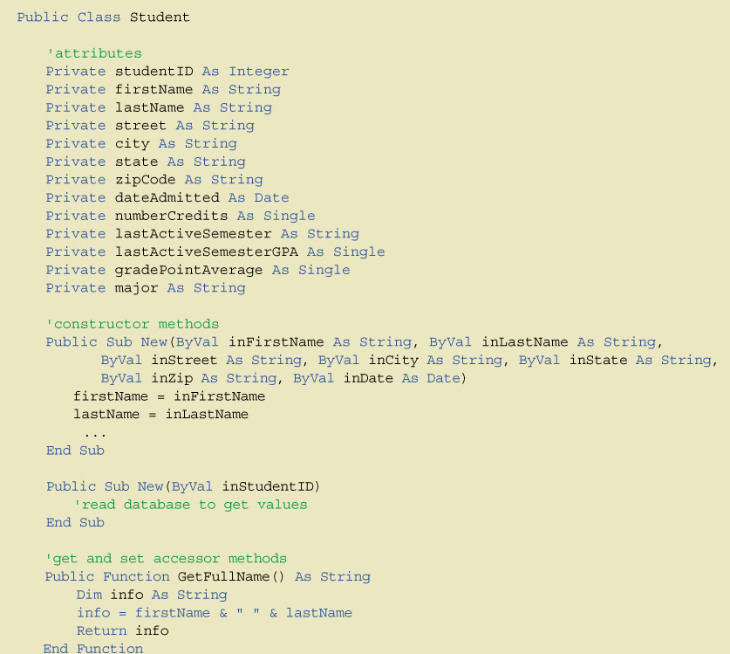
Sample VB.net with Methods

Slide 9
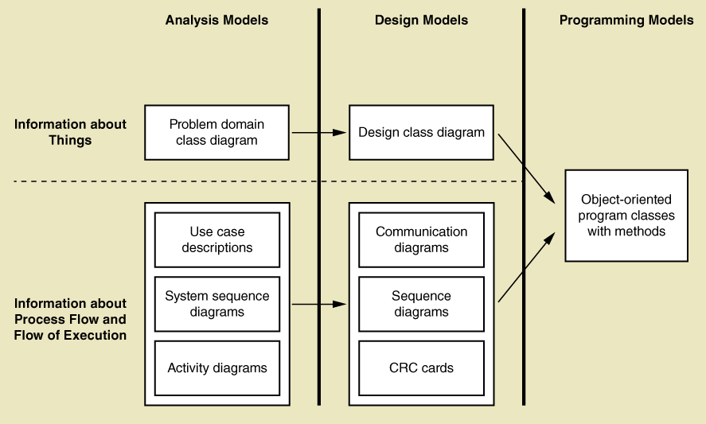
Analysis to Design to Implementation: Model Flow

Slide 10
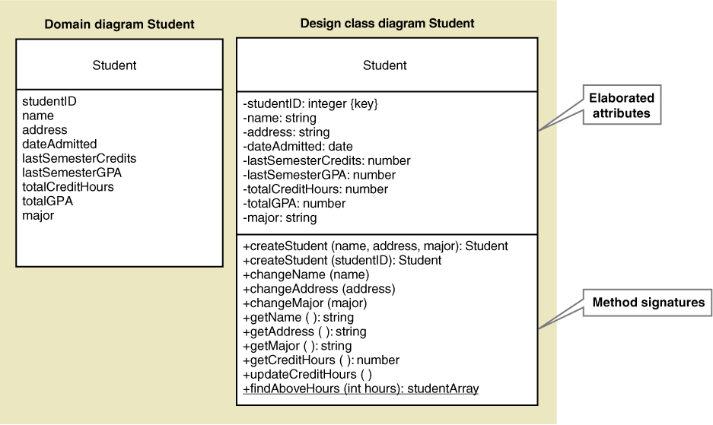
Introduction to Design Models: Class Diagram

Slide 11
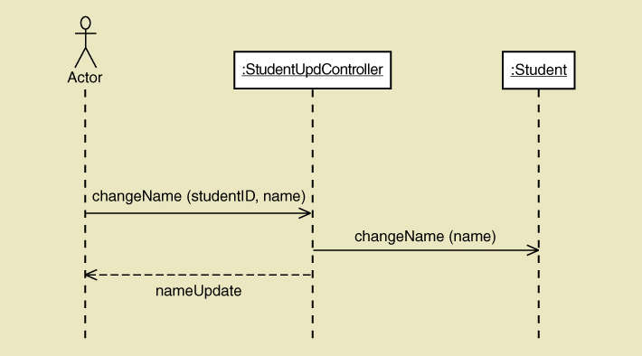
Introduction to Design Models: Sequence Diagram

Slide 12
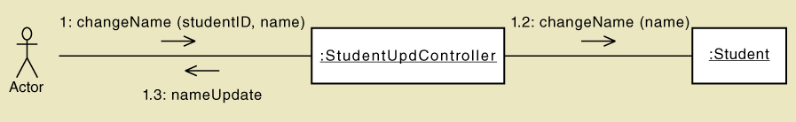
Introduction to Design Models: Communication Diagram

Slide 13
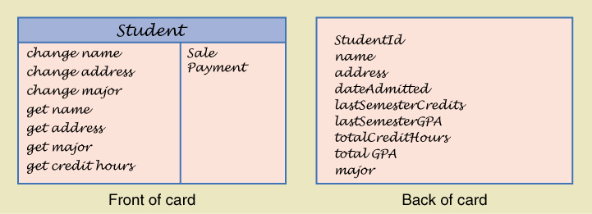
Introduction to Design Models: Class-Responsibility-Collaboration (CRC)

Slide 14
Steps of Object-Oriented Design
Object-oriented design
The process to identify the classes, their methods and the messages required for a use case
Use case driven
Design is carried out use case by use case

Slide 15
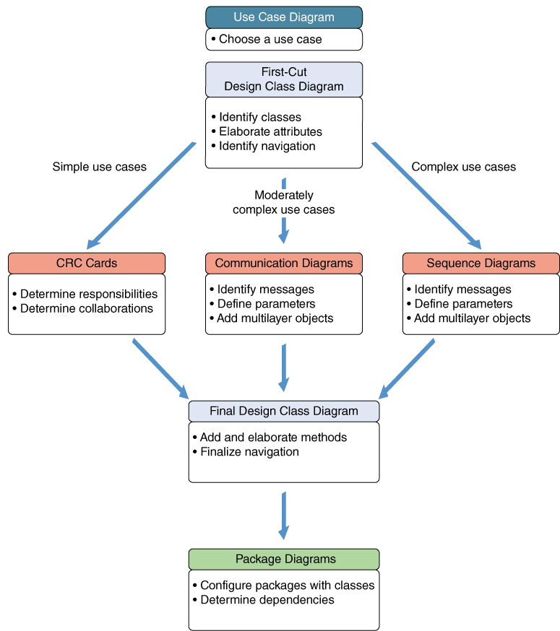
Steps of Object-Oriented Design
Three paths
Simple use case use CRC Cards
Medium use case use Communication Diagram
Complex use case use Sequence Diagram

Slide 16
Design Class Diagrams
stereotype a way of categorizing a model element by its characteristics, indicated by guillemots (<< >>)
persistent class an class whose objects exist after a system is shut down (data remembered)
entity class a design identifier for a problem domain class (usually persistent)
boundary class or view class a class that exists on a system’s automation boundary, such as an input window form or Web page
controller class a class that mediates between boundary classes and entity classes, acting as a switchboard between the view layer and domain layer
data access class a class that is used to retrieve data from and send data to a database

Slide 17
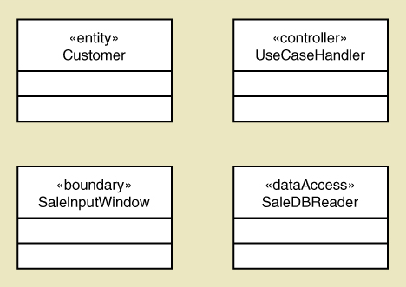
Design Class Stereotypes

Slide 18
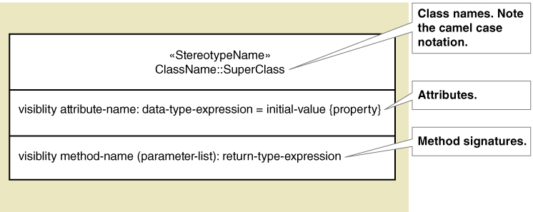
Notation for a Design Class
Syntax for Name, Attributes, and Methods

Slide 19
Notation for Design Classes
Attributes
Visibility—indicates (+ or -) whether an attribute can be accessed directly by another object. Usually private (-) not public (+)
Attribute name—Lower case camelback notation
Type expression—class, string, integer, double, date
Initial value—if applicable the default value
Property—if applicable, such as {key}
Examples:
-accountNo: String {key}
-startingJobCode: integer = 01

Slide 20
Notation for Design Classes
Method Signature
The notation for a method, contains the information needed to invoke a method
Methods
Visibility—indicates (+ or -) whether an method can be invoked by another object. Usually public (+), can be private if invoked within class like a subroutine
Method name—Lower case camelback, verb-noun
Parameters—variables passed to a method
Return type—the type of the data returned
Examples:
+getName(): string (what is returned is a string)
-checkValidity(date) : int (assuming int is a returned code)

Slide 21
Notation for Design Classes
Class level method—applies to class rather than objects of class (aka static method). Underline it.
+findStudentsAboveHours(hours): Array
+getNumberOfCustomers(): Integer
Class level attribute—applies to the class rather than an object (aka static attribute). Underline it.
-noOfPhoneSales: int
Abstract class– class that can’t be instantiated.
Only for inheritance. Name in Italics.
Concrete class—class that can be instantiated.

Slide 22
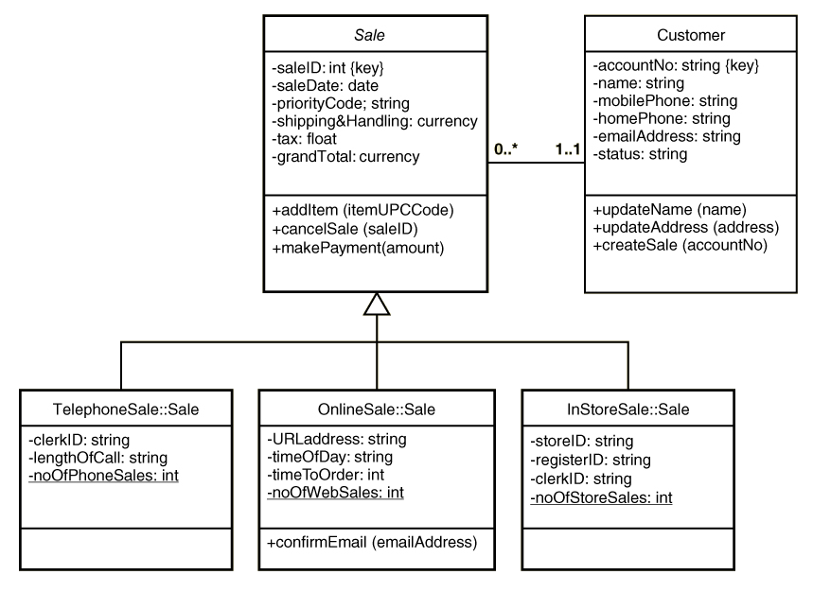
Notation for Design Classes

Slide 23
First-Cut Design Class Diagram
Proceed use case by use case, adding to the diagram
Pick the domain classes that are involved in the use case (see preconditions and post conditions for ideas)
Add a controller class to be in charge of the use case
Determine the initial navigation visibility requirements using the guidelines and add to diagram
Elaborate the attributes of each class with visibility and type
Note that often the associations and multiplicity are removed from the design class diagram as in text to emphasize navigation, but they are often left on

Slide 24
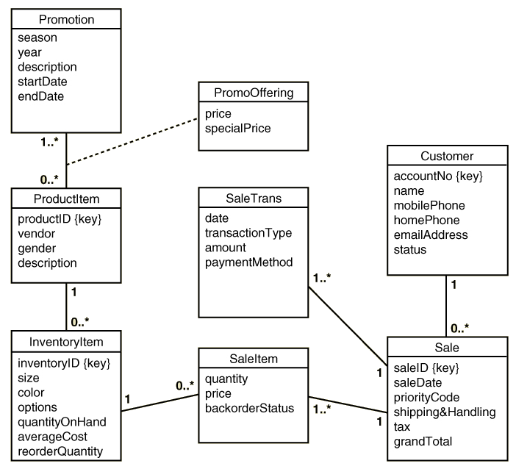
Start with Domain Class Diagram RMO Sales Subsystem

Slide 25
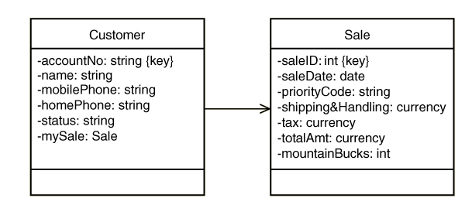
Developing Design Classes
Navigation Visibility
The ability of one object to view and interact with another object
Accomplished by adding an object reference variable to a class.
Shown as an arrow head on the association line—customer can find and interact with sale because it has mySale reference variable

Slide 26
Navigation Visibility Guidelines
One-to-many associations that indicate a superior/subordinate relationship are usually navigated from the superior to the subordinate
Mandatory associations, in which objects in one class can’t exist without objects of another class, are usually navigated from the more independent class to the dependent
When an object needs information from another object, a navigation arrow might be required
Navigation arrows may be bidirectional.

Slide 27
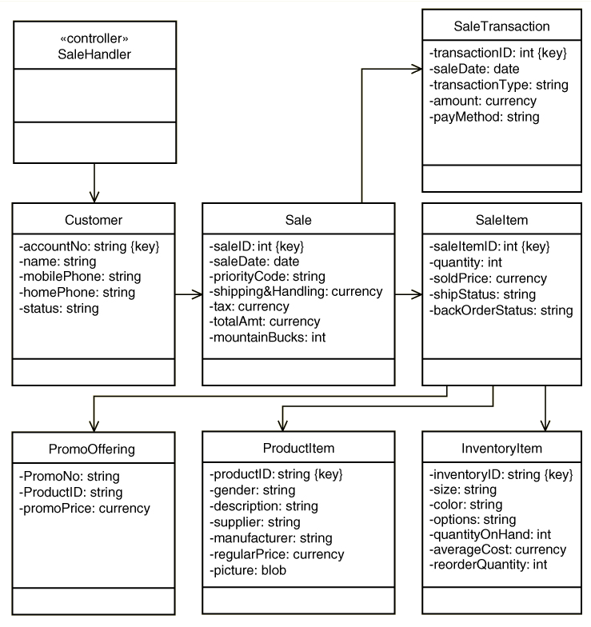
Create First Cut Design Class Diagram Use Case Create telephone sale with controller added

Slide 28
Designing With CRC Cards
CRC Cards—Classes, Responsibilities, Collaboration Cards
OO design is about assigning Responsibilities to Classes for how they Collaborate to accomplish a use case
Usually a manual process done in a brainstorming session
3 X 5 note cards
One card per class
Front has responsibilities and collaborations
Back has attributes needed

Slide 29
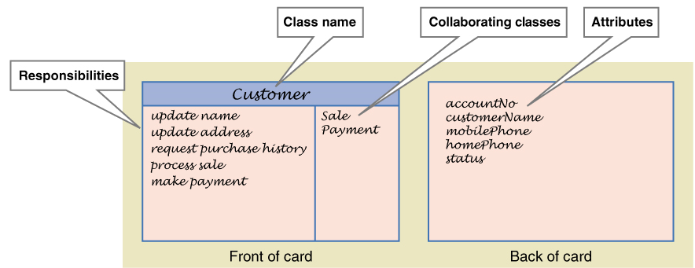
Example of CRC Card

Slide 30
CRC Cards Procedure
Because the process is to design, or realize, a single use case, start with a set of unused CRC cards. Add a controller class (Controller design pattern).
Identify a problem domain class that has primary responsibility for this use case that will receive the first message from the use case controller. For example, a Customer object for new sale.
Use the first cut design class diagram to identify other classes that must collaborate with the primary object class to complete the use case. Flesh our the cards.
Add user-interface classes to identify inputs and outputs
Add any other required utility classes

Slide 31
CRC Cards Suggestions
Start with the class that gets the first message from the controller. Name the responsibility and write it on card.
Now ask what this first class needs to carry out the responsibility. Assign other classes responsibilities to satisfy each need. Write responsibilities on those cards.
Sometimes different designers play the role of each class, acting out the use case by verbally sending messages to each other demonstrating responsibilities
Add collaborators to cards showing which collaborate with which. Add attributes to back when data is used
Eventually, user interface classes or even data access classes can be added

Slide 32
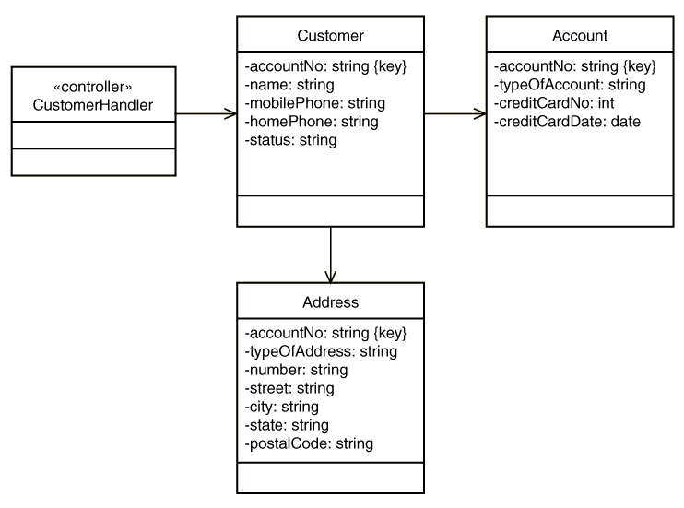
Example: Create customer Account
First-cut DCD

Slide 33
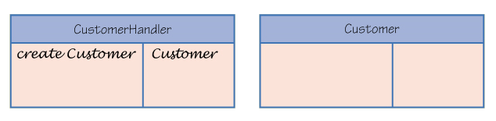
Example: Create customer account
Controller and primary domain class

Slide 34
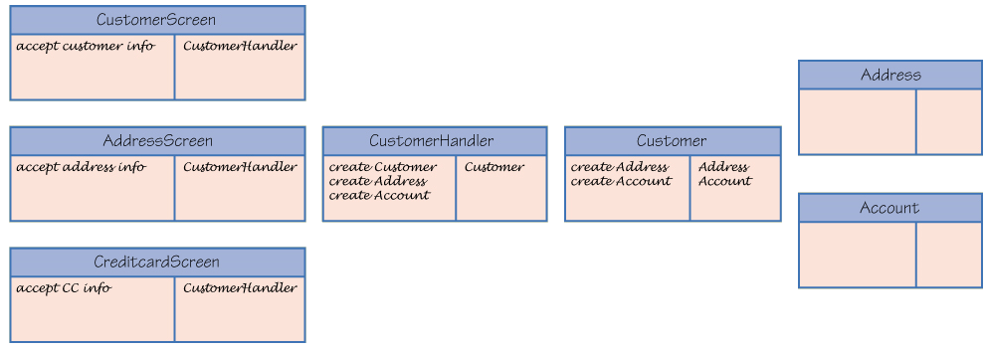
Example: Create customer account
Problem domain classes and user interface classes

Slide 35
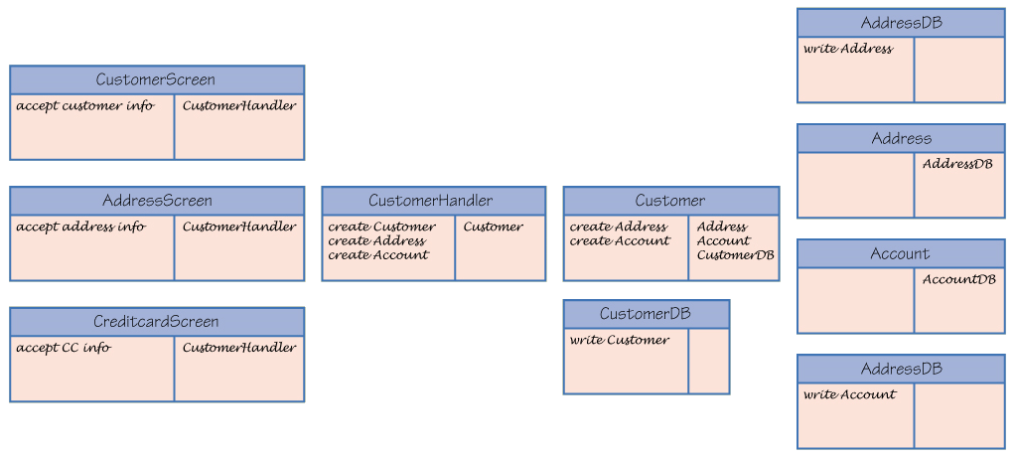
Example: Create customer account
Adding data access classes

Slide 36
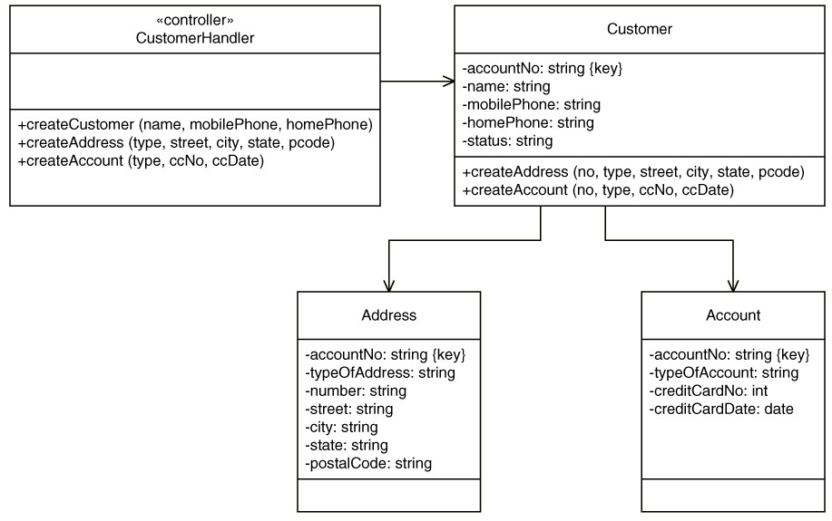
Example: Create customer account
Final DCD with method signatures

Slide 37
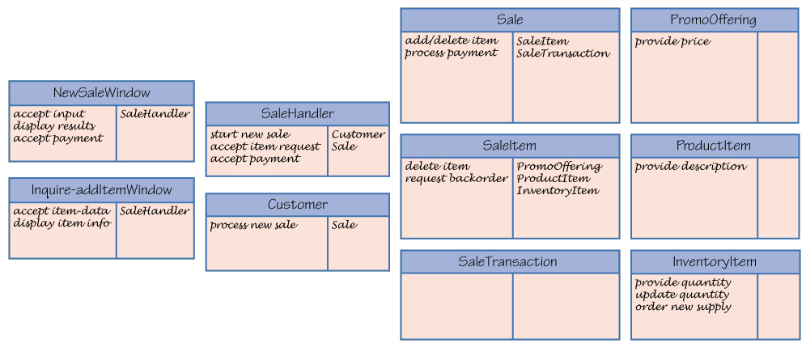
Example: Create telephone sale

Slide 38
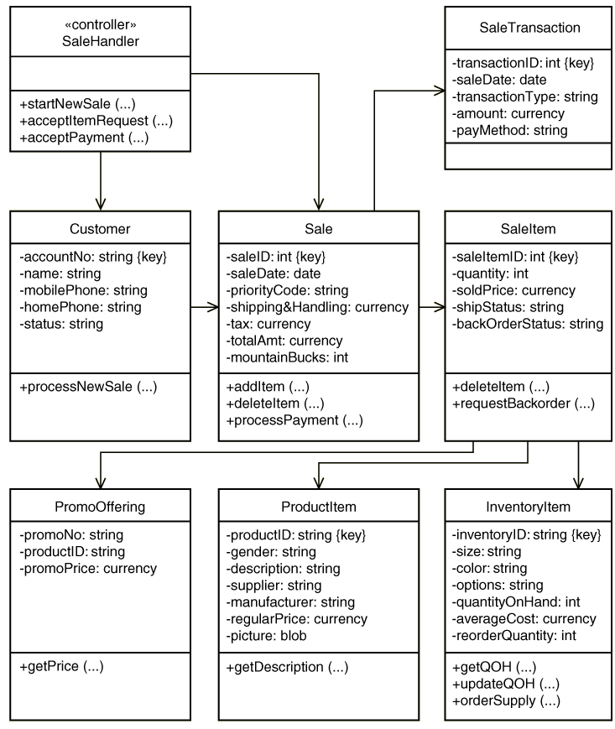
Example: DCD for Create telephone sale

Slide 39
Fundamental Design Principles
Object Responsibility
A design principle that states objects are responsible for carrying out system processing
A fundamental assumption of OO design and programming
Responsibilities include “knowing” and “doing”
Objects know about other objects (associations) and they know about their attribute values. Objects know how to carry out methods, do what they are asked to do.
Note that CRC cards and the design in the next chapter involve assigning responsibilities to classes to carry out a use case.
If deciding between two alternative designs, choose the one where objects are assigned responsibilities to collaborate to complete tasks (don’t think procedurally).

Slide 40
Fundamental Design Principles
Separation of Responsibilities
AKA Separation of Concerns
Applied to a group of classes
Segregate classes into packages or groups based on primary focus of the classes
Basis for multi-layer design – view, domain, data
Facilitates multi-tier computer configuration

Slide 41
Fundamental Design Principles
Protection from Variations
A design principle that states parts of a system unlikely to change are separated (protected) from those that will surely change
Separate user interface forms and pages that are likely to change from application logic
Put database connection and SQL logic that is likely to change in a separate classes from application logic
Use adaptor classes that are likely to change when interfacing with other systems
If deciding between two alternative designs, choose the one where there is protection from variations

Slide 42
Fundamental Design Principles
Indirection
A design principle that states an intermediate class is placed between two classes to decouple them but still link them
A controller class between UI classes and problem domain classes is an example
Supports low coupling
Indirection is used to support security by directing messages to an intermediate class as in a firewall
If deciding between two alternative designs, choose the one where indirection reduces coupling or provides greater security

Slide 43
Fundamental Design Principles
Coupling
A quantitative measure of how closely related classes are linked (tightly or loosely coupled)
Two classes are tightly coupled of there are lots of associations with another class
Two classes are tightly coupled if there are lots of messages to another class
It is best to have classes that are loosely coupled
If deciding between two alternative designs, choose the one where overall coupling is less

Slide 44
Fundamental Design Principles
Cohesion
A quantitative measure of the focus or unity of purpose within a single class (high or low cohesiveness
One class has high cohesiveness if all of its responsibilities are consistent and make sense for purpose of the class (a customer carries out responsibilities that naturally apply to customers)
One class has low cohesiveness if its responsibilities are broad or makeshift
It is best to have classes that are highly cohesive
If deciding between two alternative designs, choose the one where overall cohesiveness is high

